Slide 1

Scrum-Agile vs Waterfall
By Chris Eldred

Slide 2
Scrum-Agile Team Members
Scrum Master
Product Owner
Developer
Tester
Notes:
Talking Notes
Give a brief explanation of each of the roles

Slide 3
Scrum Master Roles
Ensuring the goals and plans for the product are understood by the whole team
Help with the product backlog management
Facilitating scrum events
Creating an environment that inspires communication
Creating an Environment that inspires innovation and creativity
Help with self-organization and cross-functionality
Help teach and spread the Agile-Scrum philosophy
Notes:
Talking Notes
Elaborate further on each point on the screen. Contrast to project manager from waterfall.

Slide 4
Product owner
Maximize product value by frequently getting user/stakeholder feedback
Create user stories
Spread information throughout the team/company
Create the product backlog and ensure everyone has access to it
Connect the development team with everyone else involved and help communication throughout the company
Notes:
Talking Notes
Elaborate on points from the slide. Contrast to a business analyst/project manager in Waterfall.

Slide 5
Tester Developer
Developing
Communal planning
Help testing
Frequent communication
Understanding the user needs
Testing
Communal planning
Help developing
Frequent communication
Understanding the user needs
Notes:
Talking Notes
Elaborate on points and explain difference between the roles within waterfall. Particular importance on the increased inter-relation under Scrum-Agile.

Slide 6
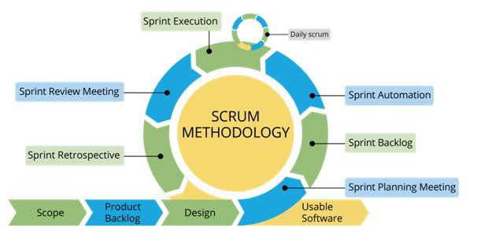
Scrum Agile phases
Notes:
Talking Notes
Explain scope and discovery, focus on how important user/stakeholder needs are
Explain product backlog, who is involved, what it is, how it is created
Explain design phase, focus on the loose design and contrast to waterfall design phase
Explain sprint planning meeting, who is involved, what is involved, the process behind decision making
Explain sprint backlog, explain difference between sprint backlog and product backlog, explain why sprints are good
Explain sprint automation
Explain sprint execution, focus on importance of daily scrum, and the dynamic nature of working in a sprint.
Explain sprint review meeting, explain who does it, why it is important, how it improves the next sprint
Explain sprint retrospective, explain difference between review meeting and retrospective, explain importance
Then explain how sprint leads into sprint until finished, explain efficiency and continual delivery of this system, show why it is adaptive to change/issues and adaptive to user needs or scope change.

Slide 7
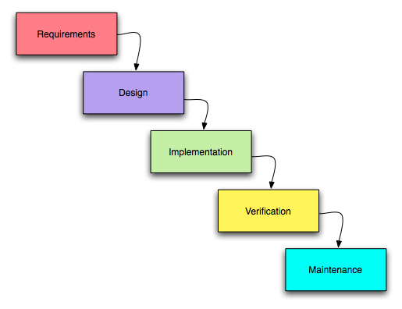
Waterfall method
Notes:
Talking Notes
Explain requirements, show difference between scope/discovery under agile. Explain rigidity of this and its inherent risk when it would be impossible to fully understand the requirements at this stage.
Explain the concreteness of the design phase under waterfall, explain the danger inherent in this, demonstrate why this is an unrealistic and inadequate way to plan
Explain implementation, explain the difference between sprint working like agile and doing all the coding in one long jog like waterfall. Show how this can lead to confusion, uncontrolled scope growth and a myriad of other problems.
Explain verification, show how risky it is to do all the coding at once and then all the testing instead of doing it simultaneously, also show how that separates developers and testers making them less effective workers
Explain maintenance, explain how maintenance as a separate phase will never lead to innovation, improvements or expansion and that this will lead to product stagnation and a drop in market share overtime.

Slide 8
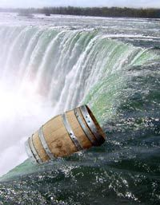
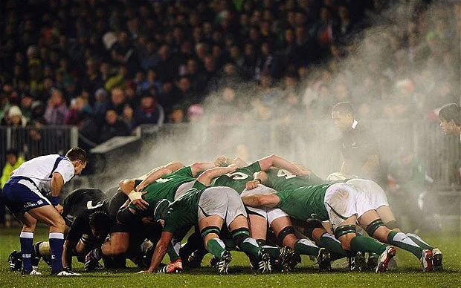
Waterfall or Scrum-agile
Notes:
Talking Notes
Emphasize the issues highlighted in the last slide, show how all these little risks and procedural rigidity lead to a massive amount of chaos in a almost structurally designed fashion
Show how Scrum-agile is much more adaptive and why that is safer and more efficient
Show how Scrum-agile is much more responsive to user/stakeholder needs and why that is very valuable
Show how Scrum-agile is ideal for inspiring collaboration and creativity, and how that will build a better product
Show how Scrum-agile is much more efficient at delivering great products with sprint deliveries and simultaneous testing
Conclude by explaining why in almost any situation it would be foolish to choose waterfall over Scrum-agile

Slide 9
References
C. (2019, October 4). Scrum Project Management: Pros and Cons. Simplilearn.Com. https://www.simplilearn.com/scrum-project-management-article
Cobb, C. G. (2015). The Project Manager’s Guide to Mastering Agile: Principles and Practices for an Adaptive Approach (1st ed.). Wiley. https://web-b-ebscohost-com.ezproxy.snhu.edu/ehost/ebookviewer/ebook/bmxlYmtfXzkzNzAwOV9fQU41?sid=0bee6731-f7ce-44e1-ad33-f54fa416be75@pdc-v-sessmgr05&vid=0&format=EB&rid=1
Hughey, D. (2009). The Traditional Waterfall Approach. Www.Umsl.Edu. http://www.umsl.edu/%7Ehugheyd/is6840/waterfall.html
patel, S. (2018, June 25). A brief Introduction to Scrum Methodology. MTC EduHub. https://mtceduhub.com/a-brief-introduction-to-scrum-methodology/
Stuff.co.nz. (2012, August 16). NZ’s great expectations play into Wallabies’ hands. Stuff. http://www.stuff.co.nz/sport/opinion/7496522/NZs-great-expectations-play-into-Wallabies-hands
The Role of a Professional Tester in an Agile World. (2015). Scrum.Org. https://www.scrum.org/resources/blog/role-professional-tester-agile-world
What is a Product Owner? (2015). Scrum.Org. https://www.scrum.org/resources/what-is-a-product-owner
What is a Scrum Master? (2015). Scrum.Org. https://www.scrum.org/resources/what-is-a-scrum-master

